Slide 1
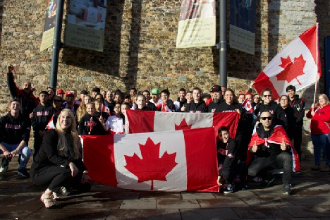
SPONSORSHIP OPPORTUNITIES
WORLD KICKBOXING AND KARATE UNION CANADA
NATIONAL QUALIFIER & WORLD CHAMPIONSHIP, CALGARY 2023

Slide 2
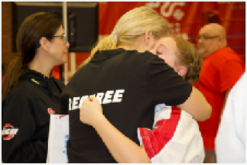
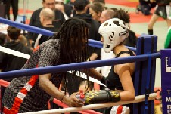
The World Kickboxing and Karate Union Canada (WKU) Canadian National Championships is the launch pad to prepare Canadian athletes and the city of Calgary for hosting of the WKU World Championships in October 2023. The Canadian National Championships will also be hosting the Canada Open Championships where upcoming athletes, ages 3 to adult, can compete as colour belts alongside the qualifying divisions. For the WKU World Championships, Calgary will be host to up to 70 countries from across the world. This will build on Alberta’s reputation as a prime destination to host national and international cultural and sporting events.
The National Championships are expected to host 400-500 athletes who will compete in a large-scale elite competition. While these types of opportunities have typically been limited especially for women and children, the Canadian National Championships presents an opportunity to allow for more safety and equality not only in competition but also within the organization. As an example, more divisions have been added specifically for women. Hosting the National Championships will create a sense of pride for martial arts athletes and bring thousands of visitors to Calgary, creating a large public benefit to our local economy.
Through a partnership with the Tsuut'ina First Nation, we are pleased and excited to welcome so many talented athletes, spectators, and coaches to our country’s beautiful, original, and cultural lands. We are happy to showcase Canada’s indigenous heritage to the world.

Slide 3
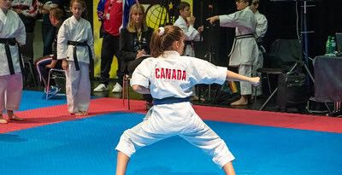
WKU Canada is a martial arts, fitness, and physical literacy organization that supports skill development and knowledge transfer of marital arts with over 4,000 members. WKU hosts events, workshops, and seminars. It also provides scholarships, learning tools, training, and classes in communities across our country.
We are inviting company and community partnerships as well as media involvement for our upcoming events. WKU is committed to building as many partnerships as possible to make these events a reality that benefits Calgary, our province, and our nation.
We already have a strong partnership with Tourism Calgary who has committed to helping us find other funding sources, make introductions to other organizations who can provide necessary resources, as well as promotional support.
Your support of these premiere events is greatly appreciated.
Regards,
Maeghen Cotterill
WKU Canada President/ Head Coach

Slide 4
SPONSORSHIP OPPORTUNITIES
$75,000 Presenting Sponsor (one available)
Exclusive naming rights and recognition at two signature events; Canadian National Championships and the World Championships.
Logo placement on all Team Canada gear kits worn by all 300 athletes and 150 coaches (team Canada uniform, opening ceremonies track suit, and competition clothing). Ability to include brand swag and give aways.
Logo placement on live stream video. Live stream can be accessed internationally, and more than 25,000 viewers are anticipated.
Logo placement on rings and mats.
Opening ceremonies.
$50,000 Black Belt Sponsor
Venue - for both Canadian National Championships and the World Championships.
Meals - inspired by Tsuut’ina Nation culinary chefs or customizable option.
$30,000 Brown Belt Sponsor
Entertainment – indigenous artists, dancers and singers.
Videographers and event production.
Or customizable option.
$25,000 Red Belt Sponsor
Guest gifts – keepsake with your corporate logo.
Technology – scoreboards, facilitators, timekeeping.
VIP reception.
Social Media – tagged in all social media posts and logo on social media ads.
Or customizable option.

Slide 5
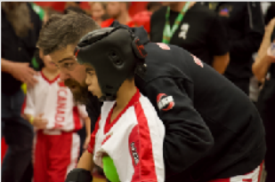
SPONSORSHIP OPPORTUNITIES
$10,000 Blue Belt Sponsor
Safety – referees, medical station, and equipment.
Female empowerment – fair, equal and safe weight classes for women.
Transportation – crew and athletes.
Fueling athletes – refreshments for athletes and crew.
Photographer and video booth.
Athlete warm up rooms.
Tip tap – all funds collected will support scholarships for athletes or customizable options.
$5,000 Green Belt Sponsor
Volunteer sponsor – t-shirts, refreshments, training.
Parking sponsors.
Athlete physical therapy.
Community sponsor – tickets and entrance provided to local schools and community groups.
Scholarships for athletes.
Sumo wrestling.
Research partner – support with developing a diversity and inclusion code of conduct to promote the safety, equality and security for all competitive international athletes.

Slide 6
SPONSORSHIP RECOGNITION BENEFITS
 | $75k | $50k | $30 | $25k | $10k | $5k
VIP Reception | 30 | 25 | 20 | 15 | 10 | 5
VIP Ring Side Tickets | 10 | 6 | 2
Tickets to Opening Ceremonies | 30 | 25 | 20 | 15 | 10 | 5
Event Tickets | 100 | 75 | 60 | 50 | 25 | 15
Logo on event tickets | X
Training sessions with world champion | 2-hour team building | 1-hour team building
Website logo placement | X | X | X | X | X | X
Email Communications Logo placement | X | X | X | X
Event Program | Full page ad | ½ page ad | ½ page ad | ¼ page ad | ¼ page ad
Digital & Social Media Post Mention | X | X | X | X | X | X
Signage | X | X | X | X | X | X
Speaking Opportunity at Opening Ceremonies | X
Speaking Opportunity at VIP Reception | X | X
Hosting Opportunity | X | X | X

